Slide 1
UniSpot
Kevin Buhler, Blake Hamilton, Tristan Hunt, Joanna Parker, Baxter Romero, Shuchi Shah
Notes:
Please enter which slides you will cover in this doc: https://docs.google.com/document/d/1oswuXCncW8i45xJ5hzrBx3wBUZzjJ62fTWU3oS3QjgU/edit?usp=sharing

Slide 2

Description of the Project
UniSpot is a website where you can can find out what your university's top songs
UniSpot also lets you search songs based on keywords
The trends page allows you to see when and how many times the songs was listened to
Check out you profile page to see what you’ve been listening to
Notes:
Shuchi
Think of this as an elevator pitch to sell your product. Alternatively, you could explain your vision.
Have you ever wondered what CU is listening to, or what CSU or any other college is listening to. Have you been to a party and don’t know any of the songs. Well that is the problem UniSpot has solved. UniSpot is website where you can find out what different universities are listening to. You can also search songs based on keywords to find songs for a theme. Additionally it also allows you to see when and how many times songs have been listed to.

Slide 3
Tools

Slide 4


Project Tracker/VCS Repository
GitHub Project Board
Github was our primary project management tool.
Track the progress of stories
Assign stories/tasks
Request feedback
When it came to more miscellaneous items/project planning, we used a Google Drive Folder to share documents
(Google docs w/ ideas, database diagrams, etc…)
GitHub Repository: Version Control System
We tracked all changes to code/meeting logs/milestones in git throughout the project…
This made progress iterative and unified (each pull to main reviewed and discussed)
Rating: 5 (a necessity)
Notes:
Project Tracker (Trello, Asana, or similar)
Name of the tool, logo, and purpose
Your group’s rating on how useful/good this tool/methodology was (ranked 1..5 where 5 stars is best and 1 star is useless)
Methodologies (Iterative, agile, pair programming, peer code reviews, other…

Slide 5

Database
PostgreSQL
Purpose: a powerful, open source object-relational database system
Rating: 3
Methodologies: storing, maintaining and accessing our user data
We track: username, password, university for each user
When a user indicates a liked song/listen: We track that entry as a ‘transaction,’ saving data about the song, the user, and the time they liked that song.
Notes:
Database (MySQL, PostgreSQL or similar)
Name of the tool, logo, and purpose
Your group’s rating on how useful/good this tool/methodology was (ranked 1..5 where 5 stars is best and 1 star is useless)
Methodologies (Iterative, agile, pair programming, peer code reviews, other…

Slide 6

IDE
Visual Studio Code
Purpose: enables programmers to consolidate the different aspects of writing a computer program
Rating: 4
Methodologies: iteraverive, individual programming, pair programming
Notes:
IDE (e.g. Eclipse, Code::Blocks, xCode.)
Name of the tool, logo, and purpose
Your group’s rating on how useful/good this tool/methodology was (ranked 1..5 where 5 stars is best and 1 star is useless)
Methodologies (Iterative, agile, pair programming, peer code reviews, other…
enables programmers to consolidate the different aspects of writing a computer program

Slide 7
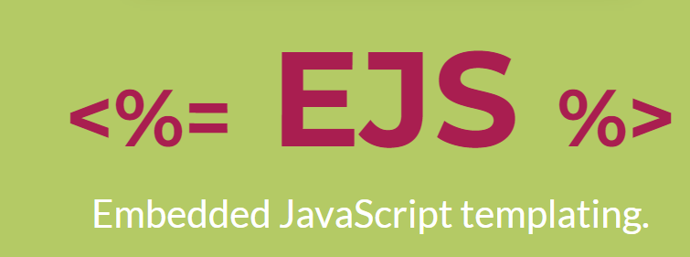

UI Tools
EJS
Purpose: embed JavaScript code in a template language that is then used to generate HTML
Rating: 2
Methodologies: create website pages
Tailwind CSS
Purpose: open source CSS framework
Rating: 4.8
Methodologies: design website pages
ChartJs
Used to create customize our data_trends barchart.
Notes:
Kevin
UI Tools (e.g. Wireframing tools, HTML, EJS etc)
Name of the tool, logo, and purpose
Your group’s rating on how useful/good this tool/methodology was (ranked 1..5 where 5 stars is best and 1 star is useless)
Methodologies (Iterative, agile, pair programming, peer code reviews, other…

Slide 8

Application Server
Node JS
Purpose: a multi-purpose server-side processing engine
Rating: 3
Methodologies: back-end use
Notes:
Application Server (NodeJS)
Name of the tool, logo, and purpose (e.g., Project Tracking, VCS)
Your group’s rating on how useful/good this tool/methodology was (ranked 1..5 where 5 stars is best and 1 star is useless)
Methodologies (Iterative, agile, pair programming, peer code reviews, other…

Slide 9
Deployment Environment
Did not complete
Notes:
Deployment environment (LocalHost, Heroku, Google, or similar)
Name of the tool, logo, and purpose
Your group’s rating on how useful/good this tool/methodology was (ranked 1..5 where 5 stars is best and 1 star is useless)
Methodologies (Iterative, agile, pair programming, peer code reviews, other…

Slide 10

External APIs
Rapid API
Using third party Shazam API
Purpose: consume any API using a unified format that is easy to understand and embed in your application
Rating: 4
Methodologies: understanding Shazam’s API
Notes:
Name of the tool, logo, and purpose (e.g., Project Tracking, VCS)
Your group’s rating on how useful/good this tool/methodology was (ranked 1..5 where 5 stars is best and 1 star is useless)
Methodologies (Iterative, agile, pair programming, peer code reviews, other…

Slide 11
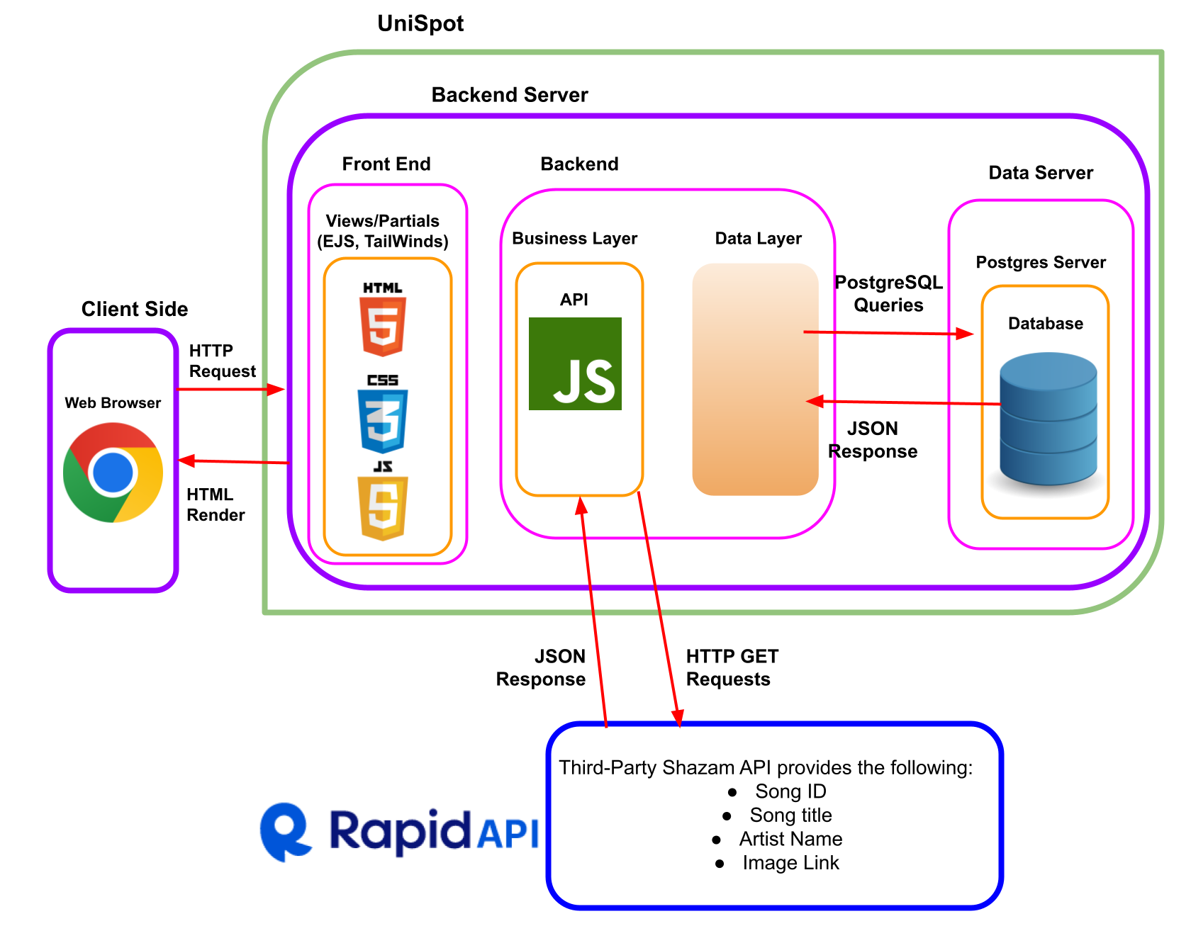
Architecture Diagram

Slide 12
Challenges
Originally we planned on using Spotify’s API, but due to it not being provided for common use we decided to use Shazam’s public API.
Password Hashing created a lot of problems for us.
We also planned on having a page for artists to view their top songs by university, but due to lack of API calls and time, it was not a feasible addition.
Notes:
Kevin

Slide 13
Demo

Slide 14
Demo
UniSpot Demo Video
Notes:
For backup, put the demo video here

Slide 15
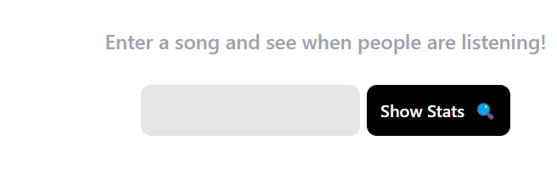
Future Enhancements
Have an artists page, where artists can find out what universities are listening to their songs
On data_trends page, searching for a song would generate a dropdown on the search bar and allow user to select the specific song they want to see data for.
Notes:
Shuchi
If there was more time there are a few features we would have liked to have added. An additional page we would have like to add is an artist page where artists are able to log on and see which universities are listening to which of their songs. Which would in the future help them decide where to tour or where to come visit. For example, cu could get their own concert from top artists. Another thing we would have like to work more on is the trends page. Currently it only works with data from our databases. We would like to have users enter any song and find the stats which would include when the song has been listened to and how many times.

Slide 16
Questions

